Slide 1
Executive summary template
  Insight 1
  The rate of customer turnover in the SME sector has been notably elevated, with a churn rate of 9.9% observed during the period spanning from January 2016 to March 2016.
  Insight 2
  The effectiveness of a 20% discount strategy is contingent upon proper targeting. It is recommended to offer the discount exclusively to customers who exhibit both a high customer value and a high probability of churn.
  Insight 3
  The predictive model successfully predicts churn, but customer price sensitivity is not the primary driver. The three main drivers of churn are yearly consumption, net margin, and forecasted consumption. These factors have a significant impact on the likelihood of churn for customers.

Slide 2
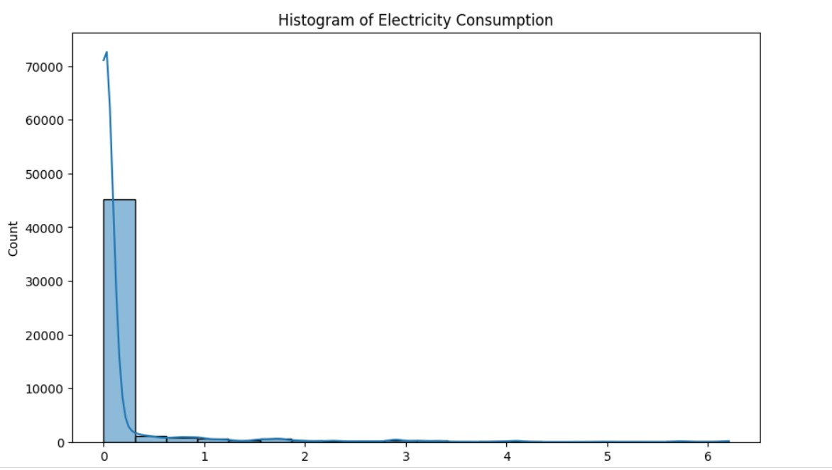
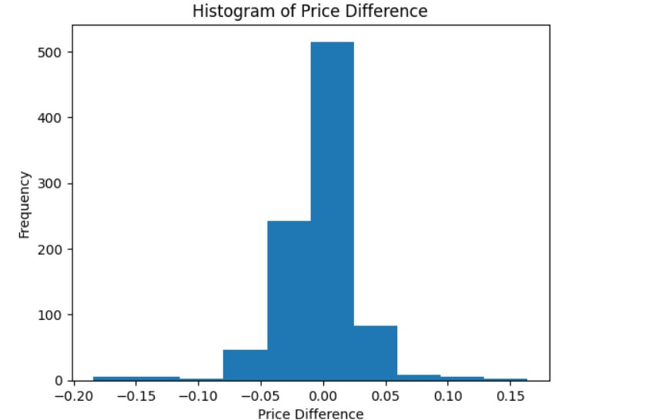
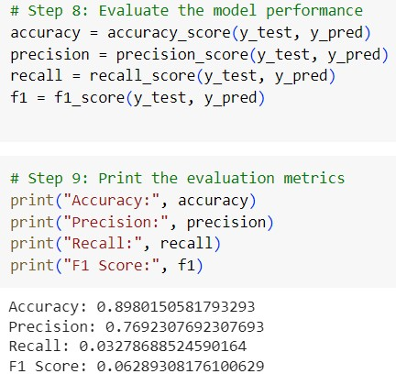
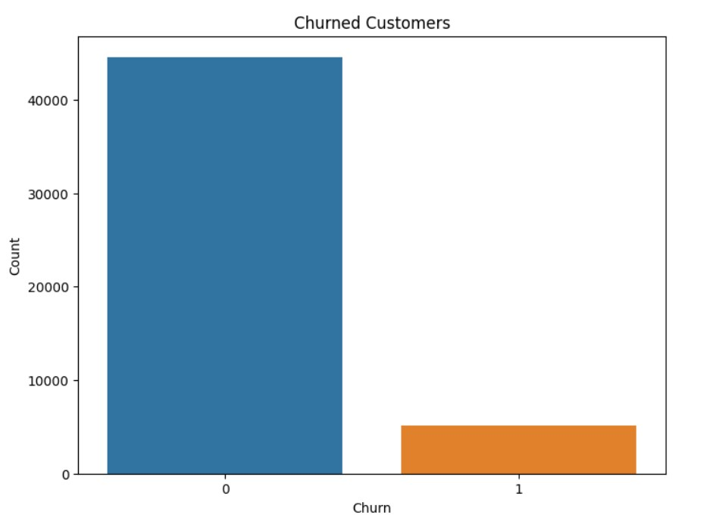
Visualization

